Slide 1
Customer booking model
PREDICTION

Slide 2
Objective
- Predict the likelihood of a customer completing a flight booking. 🔧 Model Used: - Random Forest Classifier - XGBoost (compared as alternative)

Slide 3
What Patterns Did We Discover?
Internet is King:
"The majority of bookings come from the internet sales channel, showing customers prefer self-service over agents."
Round Trips are Popular:
"Most bookings are round trips, hinting at business or planned leisure travel."
Some Routes Book More Often:
"Routes like AKL-KUL show higher booking conversion, suggesting popularity or better pricing."

Slide 4
Today’s Situation
📈 Key Metrics: - Accuracy: ~80% - F1-Score (Booked Class): ~0.32–0.36 - Model struggles with imbalance (more non-bookers than bookers) 📊 Feature Importance: - Top predictors: booking_origin, route, purchase_lead, flight_duration, length_of_stay

Slide 5
RECOMMENDATION:
We can build a lead scoring system where high-probability users (based on model output) are retargeted or given offers to nudge them toward booking
.However, due to the lower precision, this system should be used in support of human judgment, not as an automated trigger.

Slide 6
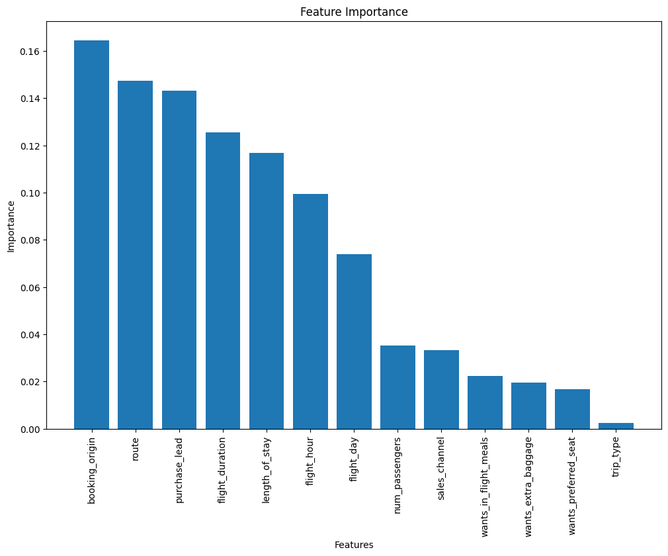
Important features

